Slide 1

Natural Language Processing
Micha Birklbauer

Slide 2
Contents
Artificial Neural Networks
Convolutional Neural Networks
Recurrent Neural Networks
Transformers
Large Language Models / Foundation Models
Generative Models
Sentiment Analysis
Image Captioning
Real-Life Example

Slide 3
What we will not talk about
Self-Normalizing Neural Networks
Rectified Factor Networks
Hopfield Networks
(Restricted) Boltzmann Machines
Reinforcement Learning
Vector Databases
Fast Similarity Searches
Recommender Systems

Slide 4
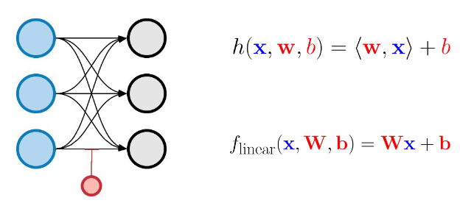
Artificial Neural Networks

Slide 5
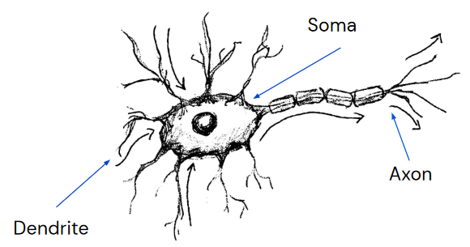
Real Neurons
Dendrites: Connections to other neurons or cells forwarding signals
Soma: Signal processing
Axon: Outgoing signal

Slide 6
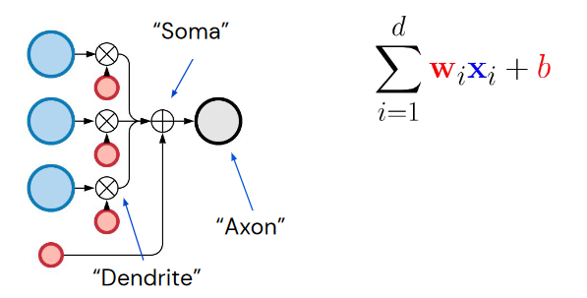
Artificial Neurons
Sum of inputs times their weights plus bias
Depending on the activation function you take another aggregation instead of the sum
Artificial neurons are NOT a model of real neurons, they just capture some simplistic properties of the biological model

Slide 7
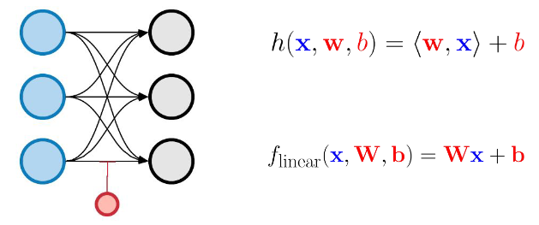
Linear Layer
Every input unit (neuron) is connected to every output unit
For linear (identity) activation function (f(x) = x) our model simplifies to Wx + b
W: Matrix of weights
x: input vector

Slide 8
Linear Layer
For any other (non-linear) activation function the activation function is applied point-wise to Wx + b
Matrix multiplications can be done very efficient
Highly optimized hardware (GPU/TPU)

Slide 9
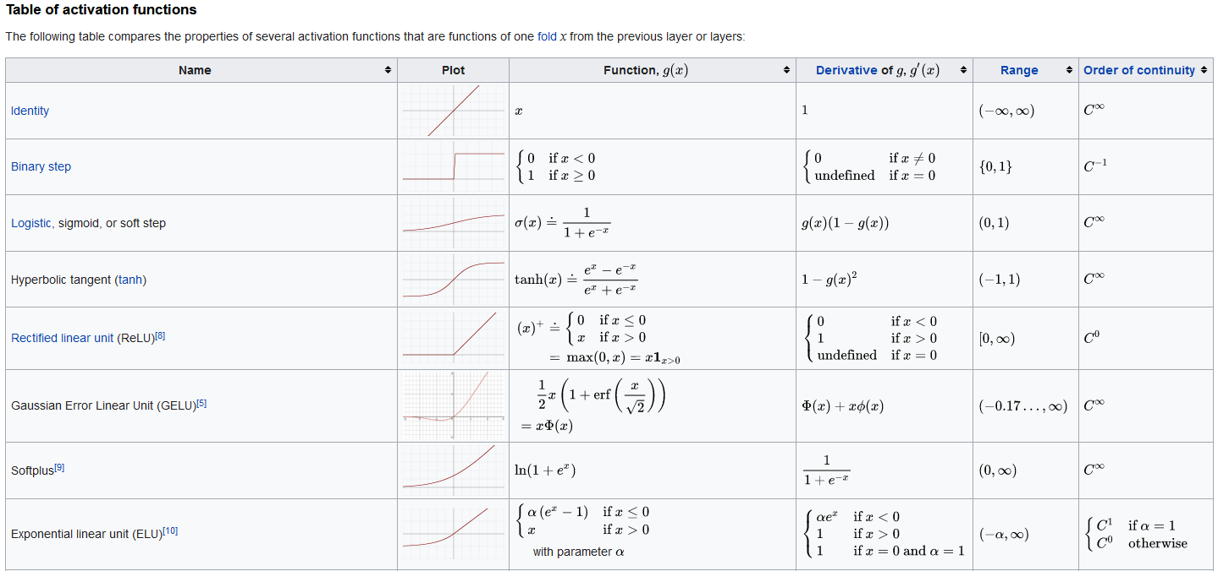
Activiation Functions
etc…

Slide 10
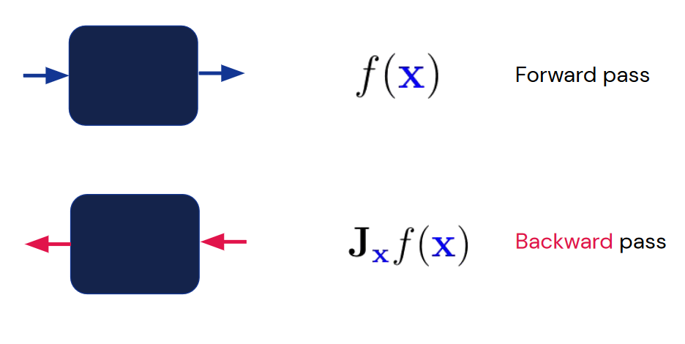
Learning
W (and b) are adjusted using gradient descent (Jacobian)
Converges to local minimum
Works for any „smooth enough“ function

Slide 11



Implementations
Two popular frameworks:
TensorFlow (Google)
[Py]Torch (Meta)
The given examples are implemented in TensorFlow / Keras
Implementing low-level functions rarely necessary unless you invent your own layer type or loss function
Example feed-forward neural network implementation from scratch: michabirklbauer.github.io/neuralnet

Slide 12
Artificial Neural Networks in NLP
Classic feed-forward neural networks can be used like any other classification algorithm for any text classification task
Works with any feature representation (Binary, Count, TF-IDF, 2Vec)
Eager-learning: Predictions are very, very fast (learning not so much)
Can approximate any decision boundary arbitrary well…
…BUT this very easily leads to overfitting (more likely than basic classifiers like naiveBayes or kNN)
A lot more hyperparameters to tune compared to other classifiers

Slide 13
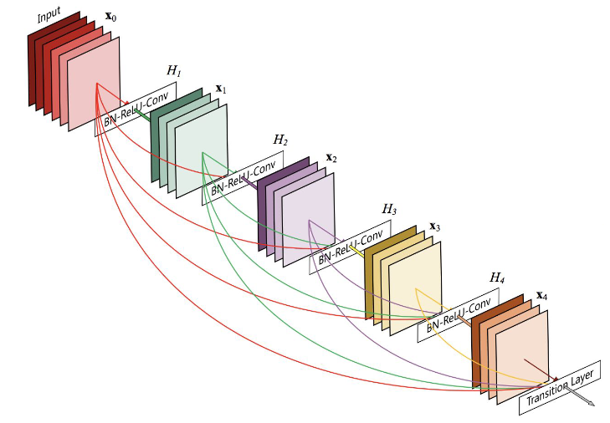
Convolutional Neural Networks

Slide 14
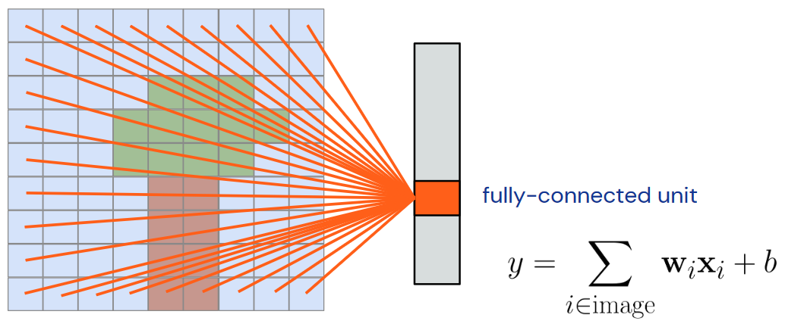
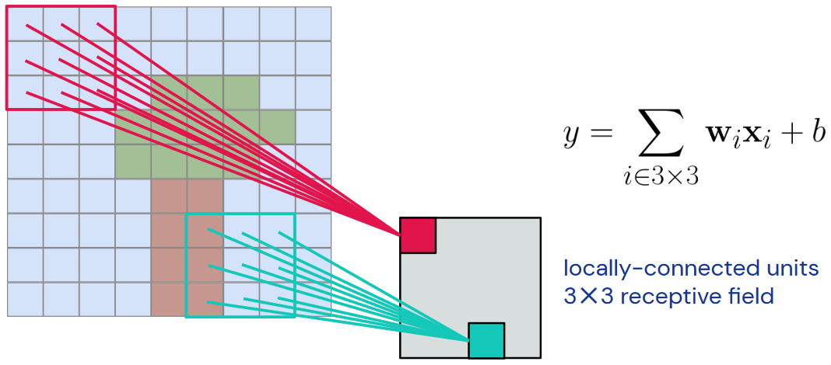
Convolution
Instead of fully connected input units we use locally connected units
These 3 x 3 receptive fields are called kernels and summarize the features in the 3 x 3 field creating a feature map (channel)
By applying different kernels we get different channels

Slide 15
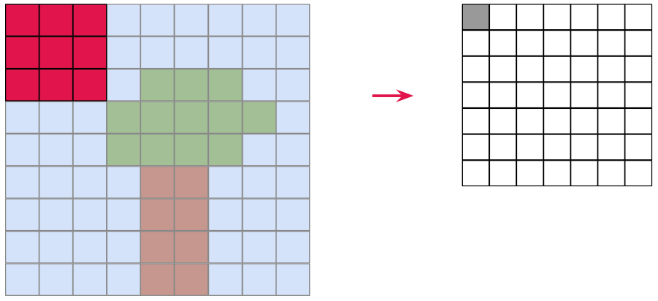
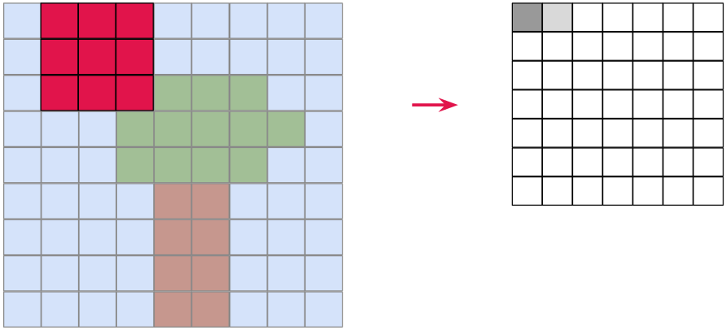
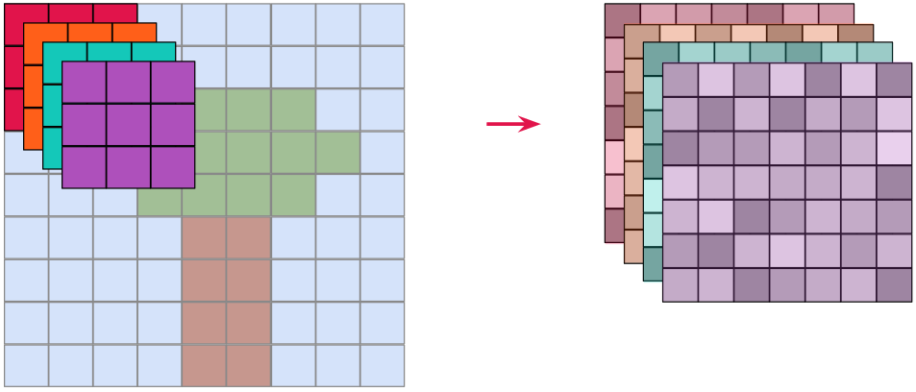
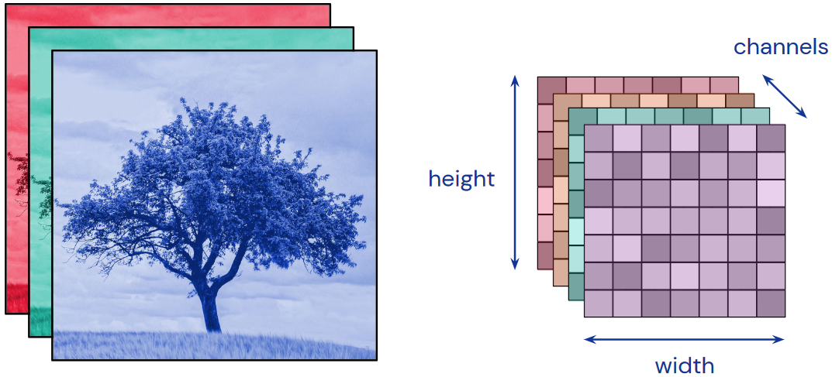
Convolution
The kernel slides across the image and produces an output value at each position
We convolve multiple kernels and obtain multiple feature maps or channels

Slide 16
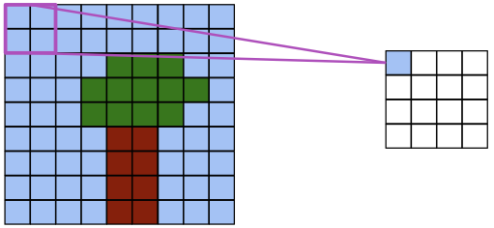
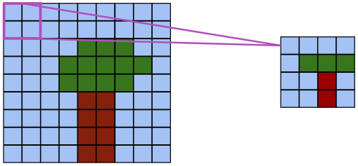
Pooling
Compute mean or max over small windows to reduce dimensionality

Slide 17
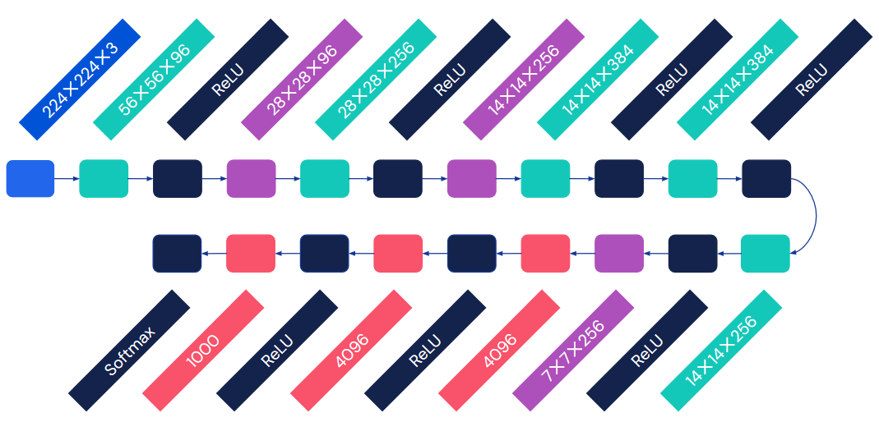
Example of a deep CNN (AlexNet)
Convolution
Pooling
Input
Fully Connected

Slide 18
CNNs for NLP
Similar to classic feed-forward neural networks mostly used for classification tasks
Instead of a 2D (3D) image we have a 1D (2D) sequence of tokens, therefore 1D convolutional layer
Captures some of the sequence aspects of texts e.g. words appearing together
Same pros and cons of a classic ANN

Slide 19
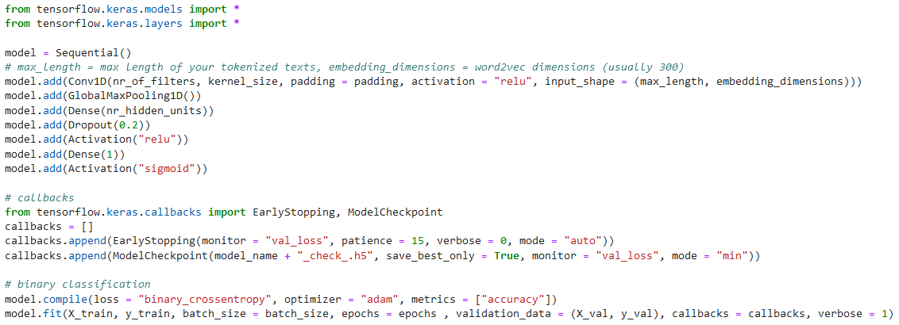
Minimal Keras NLP CNN Example

Slide 20
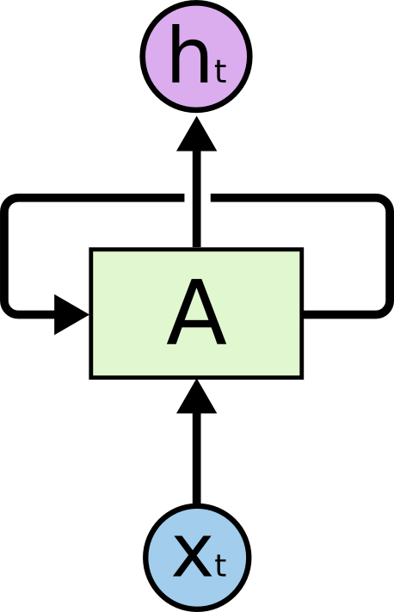
Recurrent Neural Networks

Slide 21
Texts are Sequences
Texts are sequences of tokens/words
Elements in the sequence can be repeated
The order of elements matters
Elements may refer to other (earlier/later) elements in the sequence
Sequences are of variable length
None of the previously discussed models reflect these properties very well

Slide 22
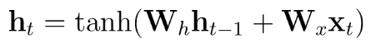
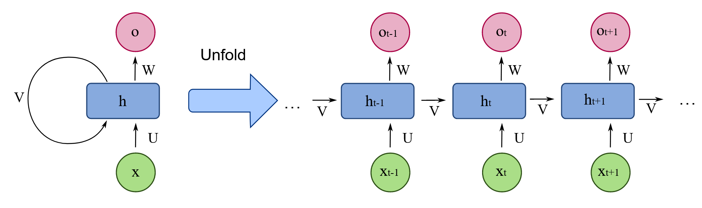
Recurrent Neural Networks
Persistent state variable h stores information from the context observed so far

Slide 23
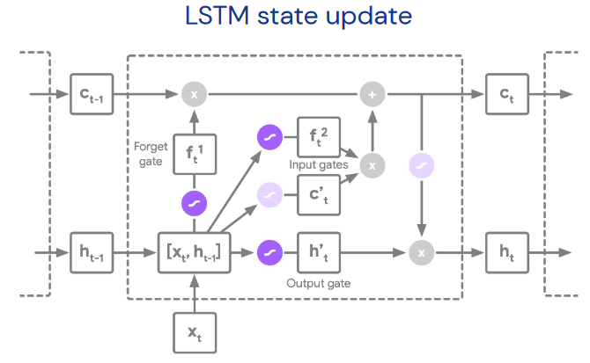
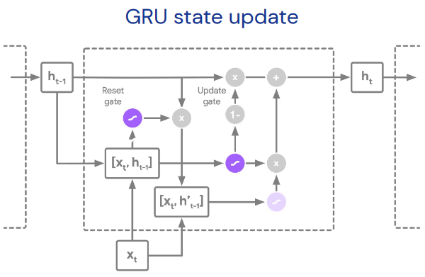
Recurrent Neural Networks
Many variations of recurrent networks exist additionally to the classic RNN:
Long Short-Term Memory (LSTM) networks
Bi-directional LSTM networks
Gated Recurrent Unit (GRU) networks
Bi-directional GRU networks

Slide 24
RNNs for NLP
Captures the sequential aspect of texts very well
Basically the standard if you are not using transformers
Used for classfication and generative tasks
Again same pros and cons of classic ANNs

Slide 25
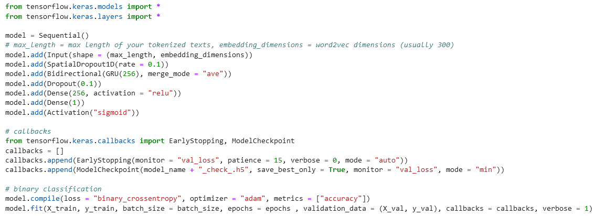
Minimal Keras NLP RNN Example

Slide 26
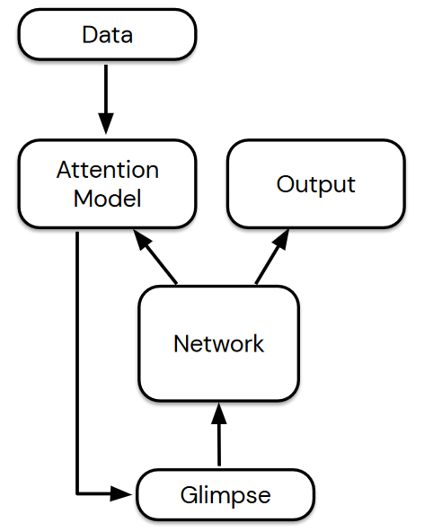
Transformers

Slide 27
Attention
The ability to focus on one thing and ignore others has a vital role in guiding cognition
Deep neural networks naturally learn a form of implicit attention where they respond more strongly to some parts of the data than others
We can add explicit attention by having a seperate attention model

Slide 28
Neural Attention Models
The network produces an extra output vector used to parameterize an attention model
The attention model then operates on some data (image, audio sample, text to be translated...) to create a fixed-size “glimpse” vector that is passed to the network as input at the next time step
The complete system is recurrent, even if the network isn’t

Slide 29
Transformers
Transformer networks take attention to its logical extreme: get rid of everything else (recurrent state, convolutions, external memory) and just use attention to repeatedly transform a complete sequence (Attention is all you need)
State-of-the-Art for most NLP tasks like next-sentence prediction, question answering, reading comprehension, sentiment analysis, paraphrasing, machine translation, document summarization, document generation, named entity recognition
Mostly using pre-trained transformers like GPT-3 (OpenAI) or BERT (Google) instead of training it yourself (fine-tuning possible)

Slide 30

Large Language Models

Slide 31
Large Language Models
Foundation models: Large machine learning models trained on a vast amount of data with the aim of easy adoption for a variety of downstream tasks e.g. language models like GPT
Large language models: A type of foundation model notable for its ability to achieve general-purpose language understanding and generation

Slide 32
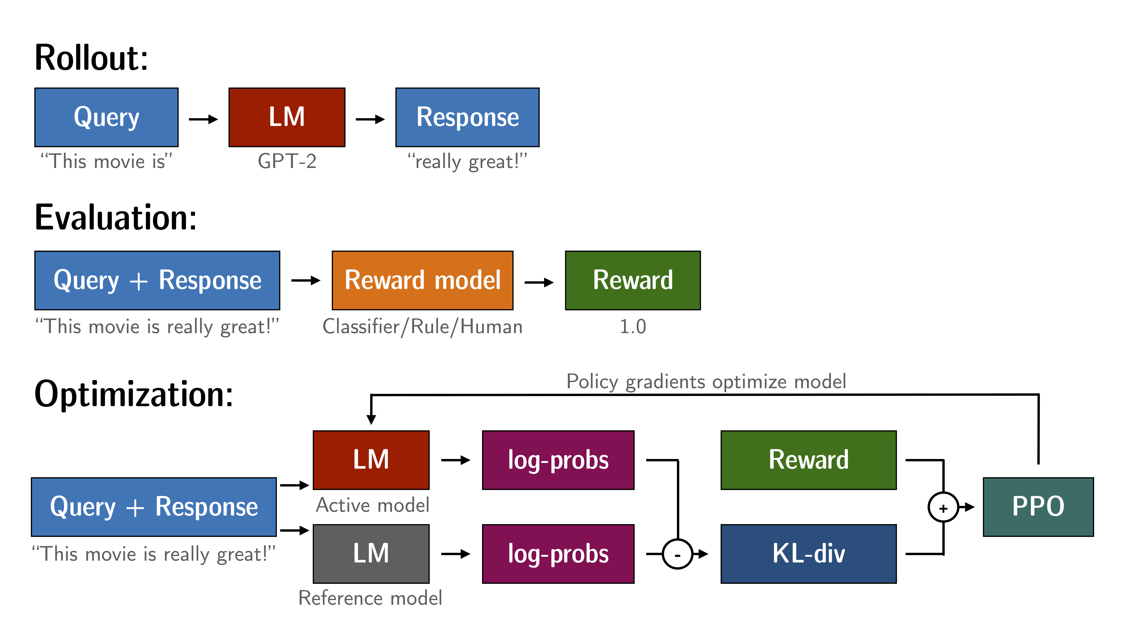
How does ChatGPT learn?
Reinforcement Learning from Human Feedback (RLHF)
Proximal Policy Optimization (PPO)
ChatGPT uses GPT-3.5 (or GPT-4) as base model
Image source: https://github.com/huggingface/trl

Slide 33
Limitations and Concerns
Outdated knowledge (trained on data up to 2021, OpenAI addressed this by giving ChatGPT access to the internet)
Insufficient understanding and producing false results
Energy consumption
Malicious usage
Bias and discrimination
See also https://doi.org/10.1016/j.metrad.2023.100017

Slide 34
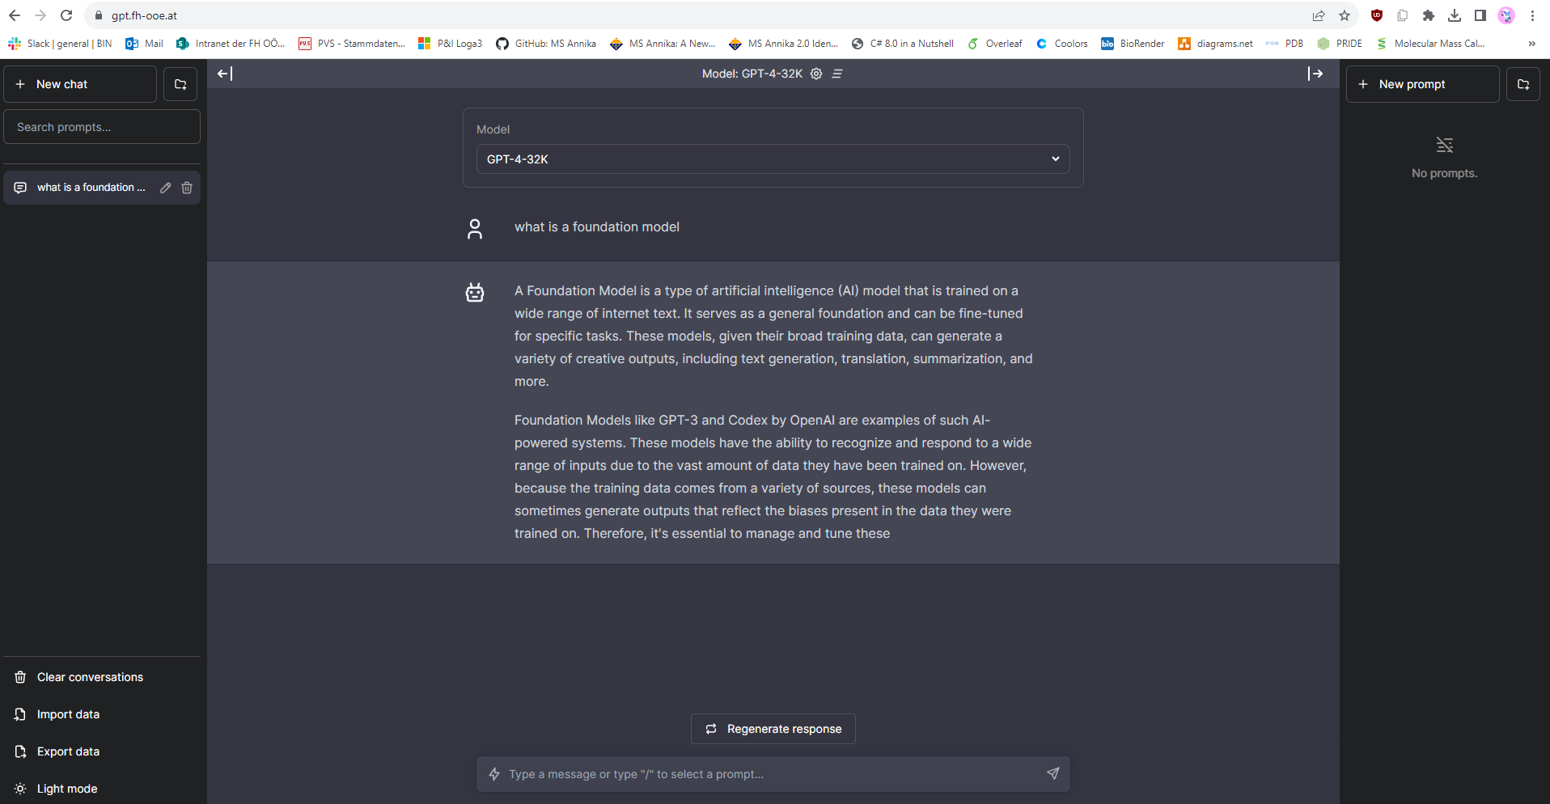
gpt.fh-ooe.at

Slide 35
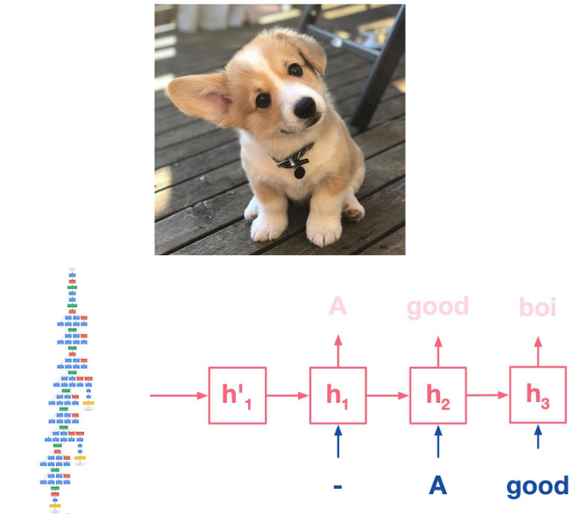
Generative Models
Sequence to Sequence Prediction

Slide 36
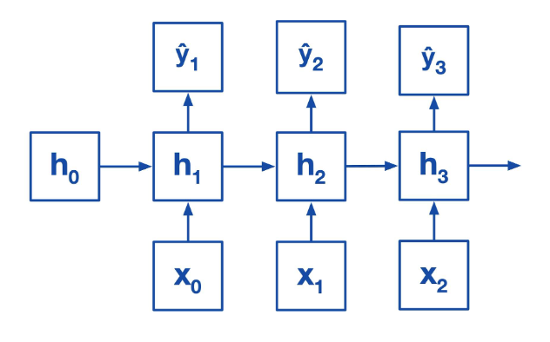
Sequence to Sequence Models
(Hidden-)States (h₀) in RNNs usually initialized with zeros…

Slide 37
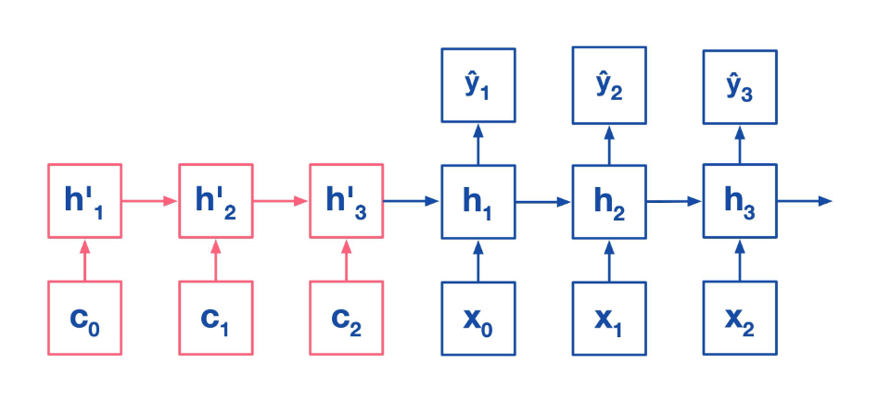
Sequence to Sequence Models
…BUT we could also initialize them with the state information of another network

Slide 38
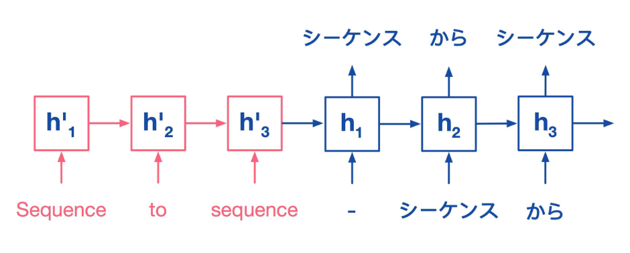
Sequence to Sequence Models
For example, two coupled (english and japanese) nets for machine translation:
Random word as initial input

Slide 39
Seq2Seq Applications
Machine translation
Image captioning
Video captioning
Image generation
Video generation
Dialogue
…

Slide 40
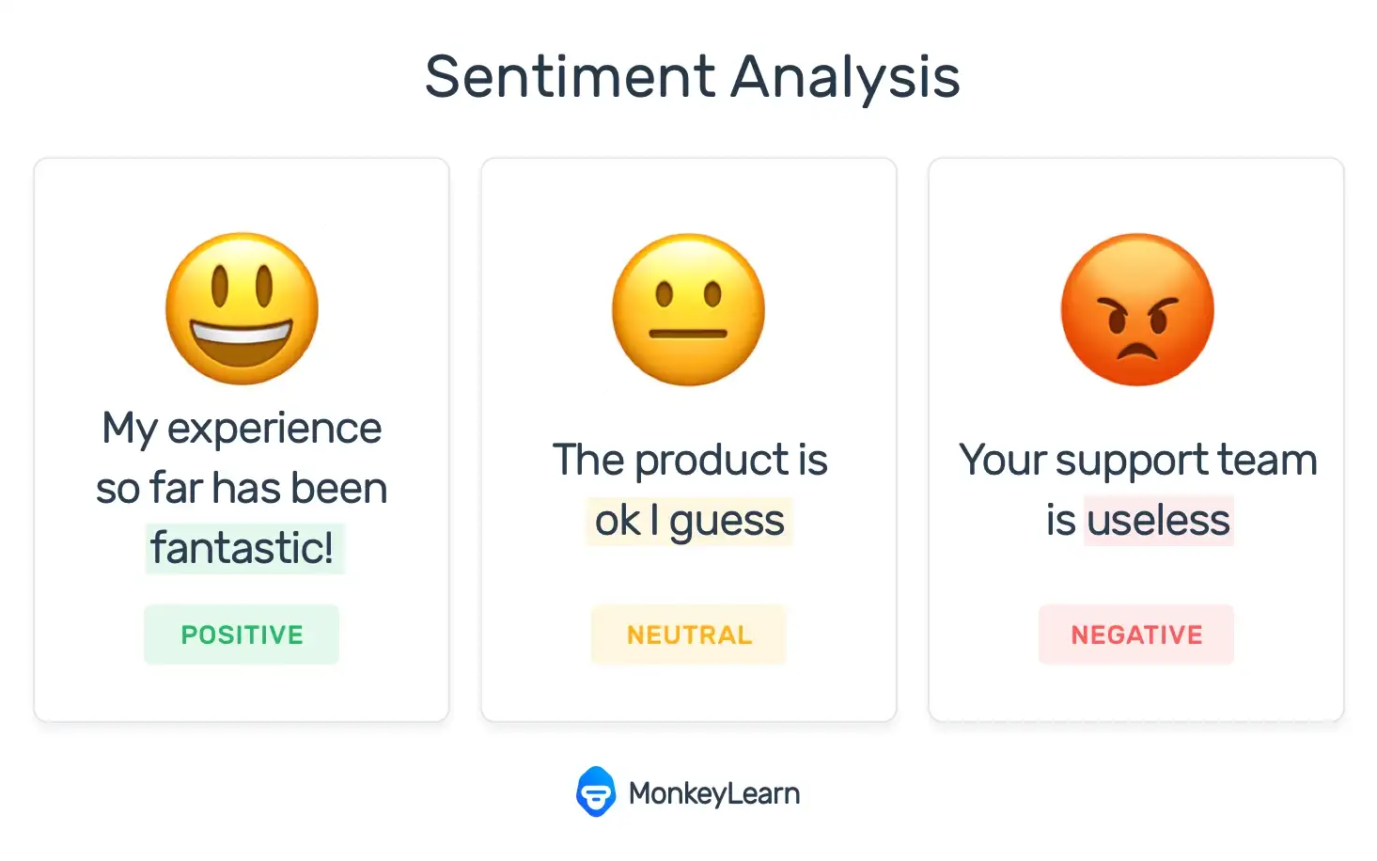
Sentiment Analysis
Source: https://monkeylearn.com/

Slide 41
Sentiment Analysis
Why sentiment analysis is important (according to Microsoft):
Social and brand monitoring: Analyzing real-time customer interactions and comments on your social channels about your brand, product, and business can offer insights into how your customers feel about all three. Companies can also use sentiment analysis of previous products as a measure for launching new products, advertising campaigns, or breaking news about your business.
Customer service: Your customer service team probably automatically sorts customer issues into urgent and not urgent. Sentiment analysis adds another layer by analyzing the language and severity of the problem in chat or email, spotlighting particularly frustrated customers for faster mediation.
Customer feedback: In line with social monitoring, you hear directly from the customer how negatively or positively they perceive a product or brand to be. Tracking keywords related to direct customer feedback shared on social media profiles, during online chats with your teams, or through other touchpoints provides an overall measurement of the success of your product, campaign, or solution.
Crisis prevention: To monitor media publishing, sentiment analysis tools can collect mentions of predefined keywords in real time. Your public relations or customer success teams can use this information to inform their responses to negative posts, possibly shortening – or even averting – a social media crisis before it can pick up speed.
Market research: It’s not just enough to know how your customers feel; you need to know why. Understanding why, or why not, customers respond the way you intended is key to planning your next move – whether through marketing, sales, or direct and personalized service responses.

Slide 42
Sentiment Analysis
Sentiment Analysis is basically a classification task
Hands-on in the following exercise:
Exercise 5: https://github.com/michabirklbauer/hgb_dse_text_mining/blob/master/Sentiment.ipynb https://colab.research.google.com/github/michabirklbauer/hgb_dse_text_mining/blob/master/Sentiment.ipynb

Slide 43
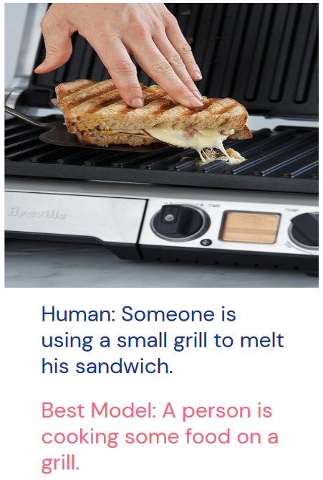
Image Captioning

Slide 44
Image Captioning
The process of adding descriptions to pictures
We are going to look at the official Keras guide to get a basic understanding of the implementation: https://keras.io/examples/vision/image_captioning/
Exercise 6: https://github.com/michabirklbauer/hgb_dse_text_mining/blob/master/Captioning.ipynb https://colab.research.google.com/github/michabirklbauer/hgb_dse_text_mining/blob/master/Captioning.ipynb

Slide 45

Image Captioning
You can even use this to automatically create memes, as presented here: https://arxiv.org/abs/1806.04510

Slide 46

Real-Life Example
Patent Classification for Roche

Slide 47
Background
Identification of relevant patents for diagnostic application is an important undertaking
Given the nature of patents it requires expert knowledge to identify relevant patents for certain applications and is often done manually
This process is time consuming and would benefit from a pre-selection classifier that can pinpoint the expert to the most relevant patents
Therefore train a classifier that can discriminate relevant from non-relevant patents

Slide 48
Data
Features: ID, Titel, Abstract, Text and IPC Code of patents
Language: English
Labels:
Label 1: non-relevant patent
Label 2: relevant patent
20 578 Samples:
Label 1: 14 391
Label 2: 6 187
Baseline:
Unbalanced: 0.6993
Balanced: 0.5000

Slide 49
Preprocessing
Title and abstract were combined
Text was preprocessed by:
Tokenization
Stemming
Stopword removal
Creation of a TF-IDF feature matrix based on tokens
Creation of word vector matrices based on FastText and Glove for neural networks

Slide 50
Methods and Classifiers
Random Forest: Ensemble classification with decision trees
Gradient Boosted Trees: Ensemble classification with residual decision tree stacking
RNN: Recurrent neural network (RNN) modeling used as classification for natural language data
Glove Word Embeddings: Glove Word Embeddings for CNN and LSTM model classification
Genetic Programming: Classification using evolutionary algorithms
K Nearest Neighbour: Classification with nearest neighbour algorithm
FastText: Feature embedding with FastText and classification with GRU-NN
GRU-NN: Classification with bi-directional Gated Recurrent Unit Neural Networks
SVM: Classification with Support Vector Machines
Naive Bayes: Classification with multinomial Naive Bayes

Slide 51
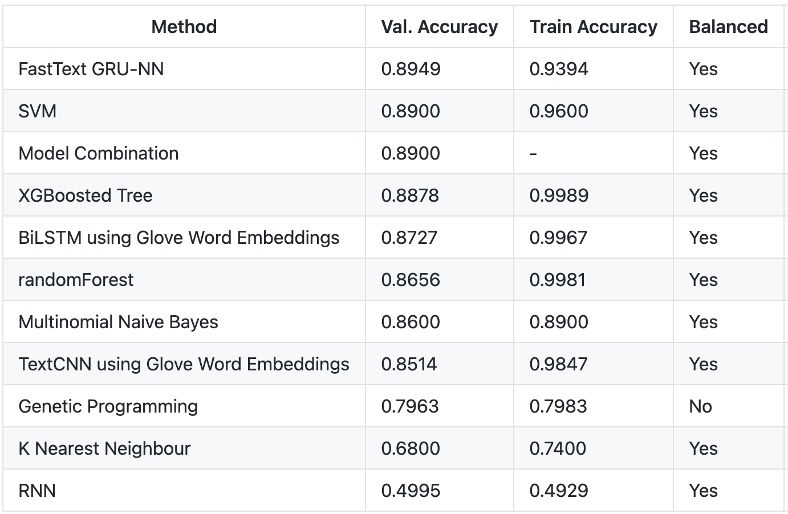
Results

Slide 52
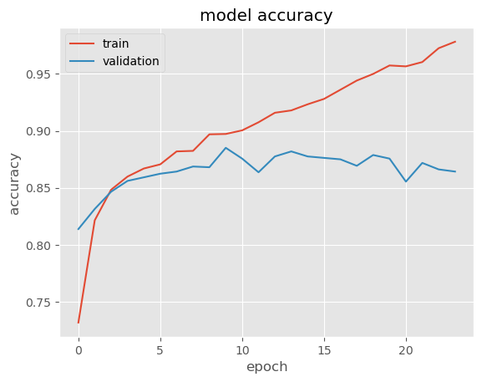
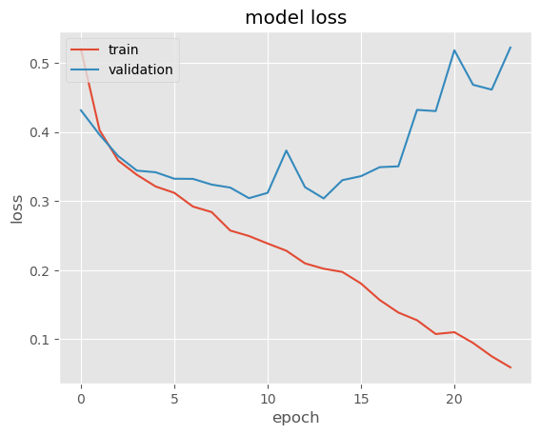
GRU-NN with FastText Features
Model Architecture:
Every word in text is encoded as a 100-dimensional feature vector
Input layer of shape (None, 200, 100)
Spatial dropout layer with 10% dropout
Bidirectional GRU layer with 256 units
Dropout layer with 10% dropout
Dense layer with 256 units and ReLU activations
Dense output layer with sigmoid activation

Slide 53
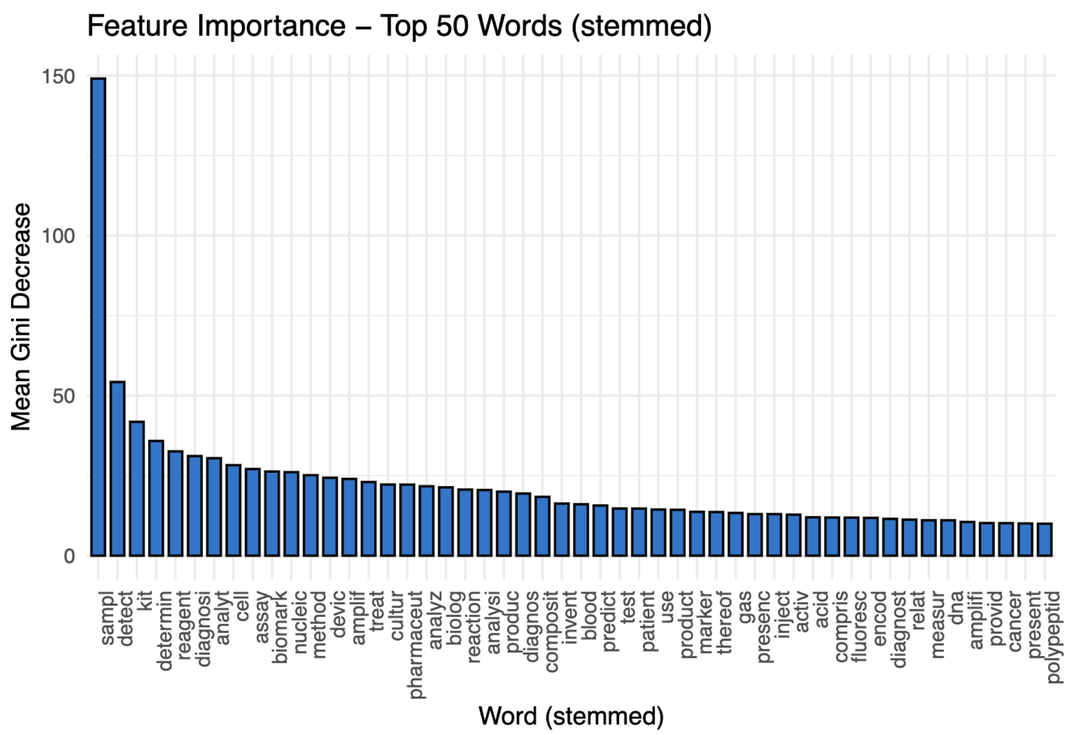
Feature Importance (RF)

Slide 54
Final Remarks

Slide 55
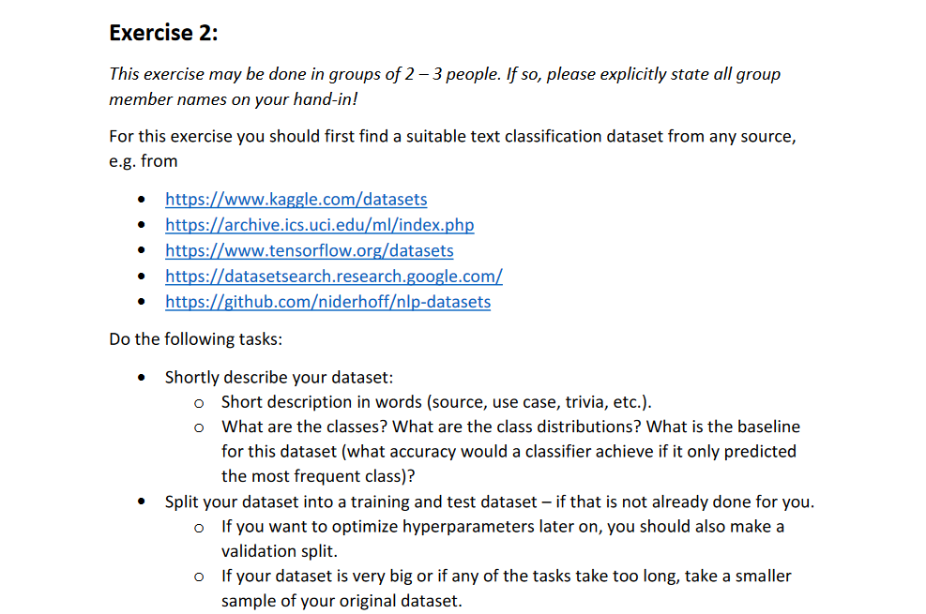
Homework/Exercise 2

Slide 56
References
A lot of the material presented here was taken from DeepMind‘s 2020 Deep Learning Lecture Series
Images are taken from there or Wikipedia, if not otherwise specified
Further links that I can recommend checking out:
GPT-3: https://github.com/openai/gpt-3, https://arxiv.org/abs/2005.14165
Paper: Analysing Mathematical Reasoning Abilities of Neural Models
Paper: Visual Grounding in Video for Unsupervised Word Translation
Blog: ScaNN: Efficient Vector Similarity Search
Blog: Transformers in R
Blog: Understanding LSTMs

Slide 57
Thanks for your participation and attention!
Merry Christmas/Happy Holidays!
Feedback & Questions:
micha.birklbauer@fh-hagenberg.at

